Slide 1
Deciding where to live
Yr 7 Geography- Liveability

Slide 2

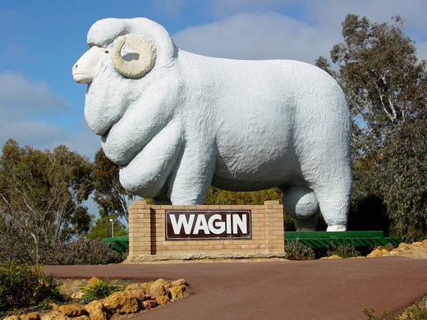
1. Attachment to place

Slide 3

2. Distance from family and friends

Slide 4
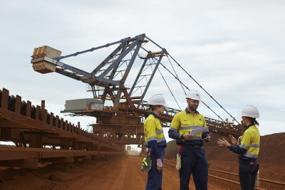
3. Employment opportunities

Slide 5
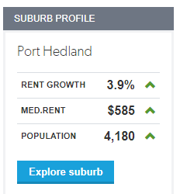
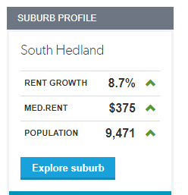
4. Affordability (price of living)

Slide 6
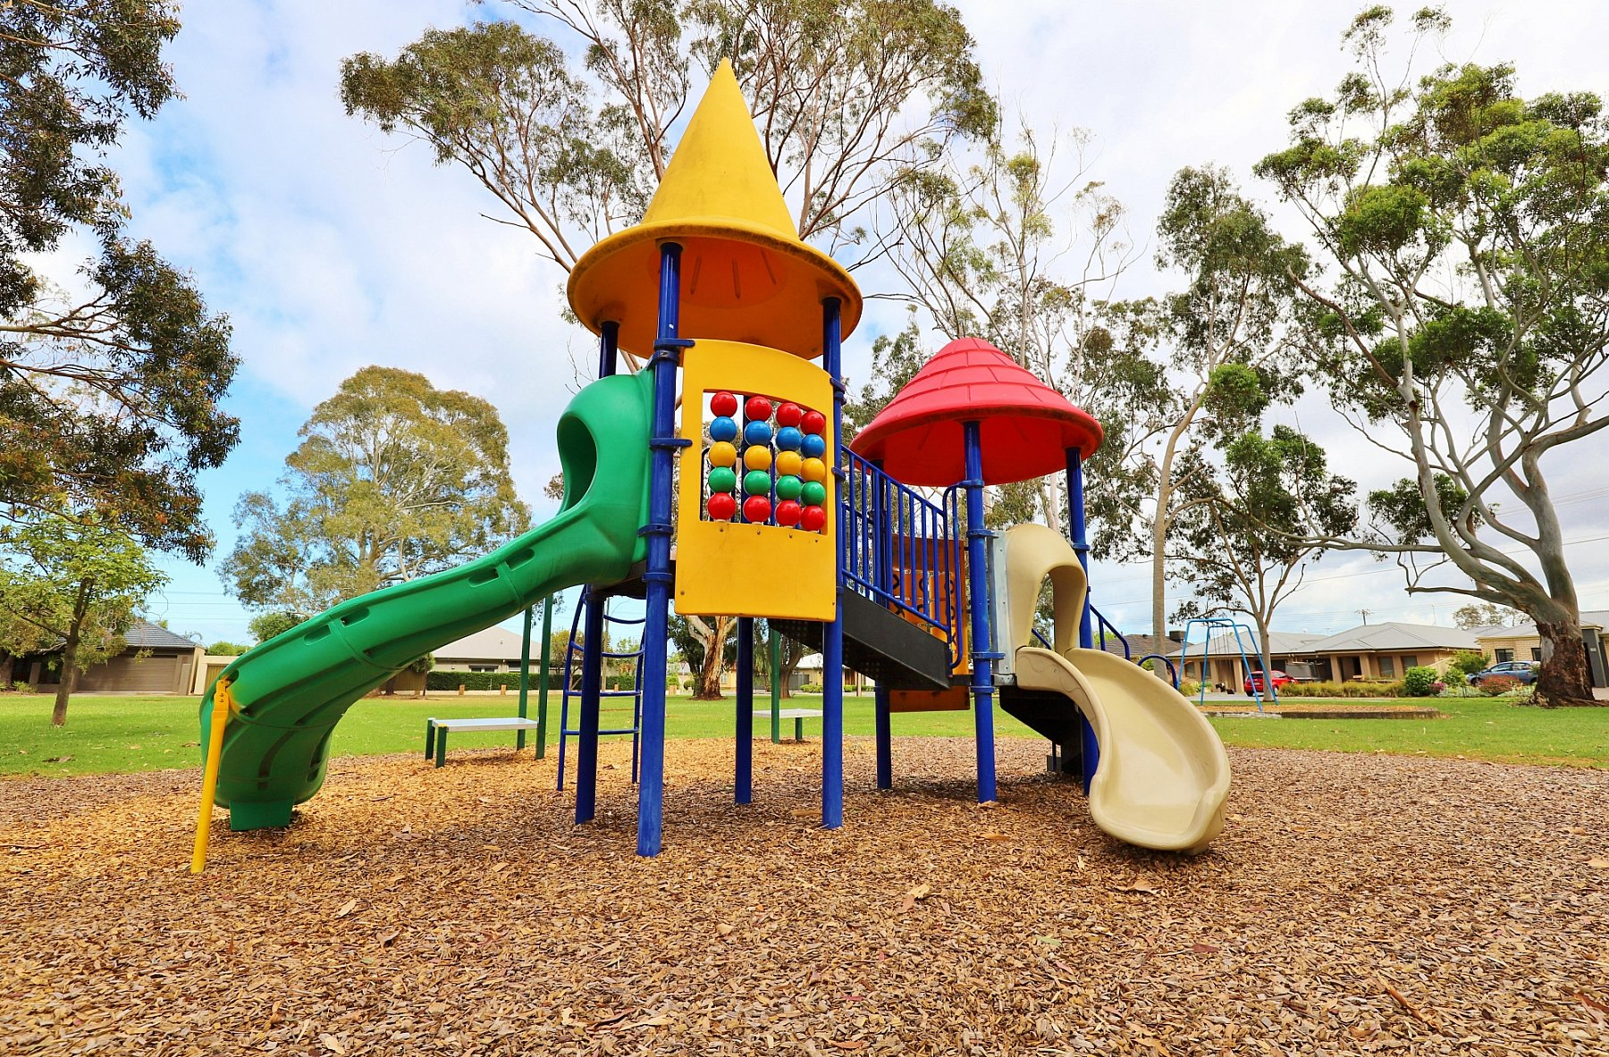
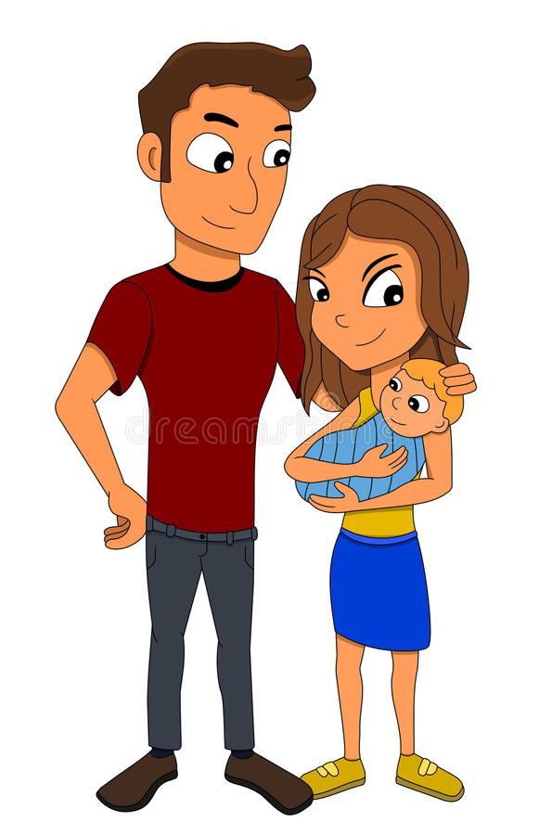

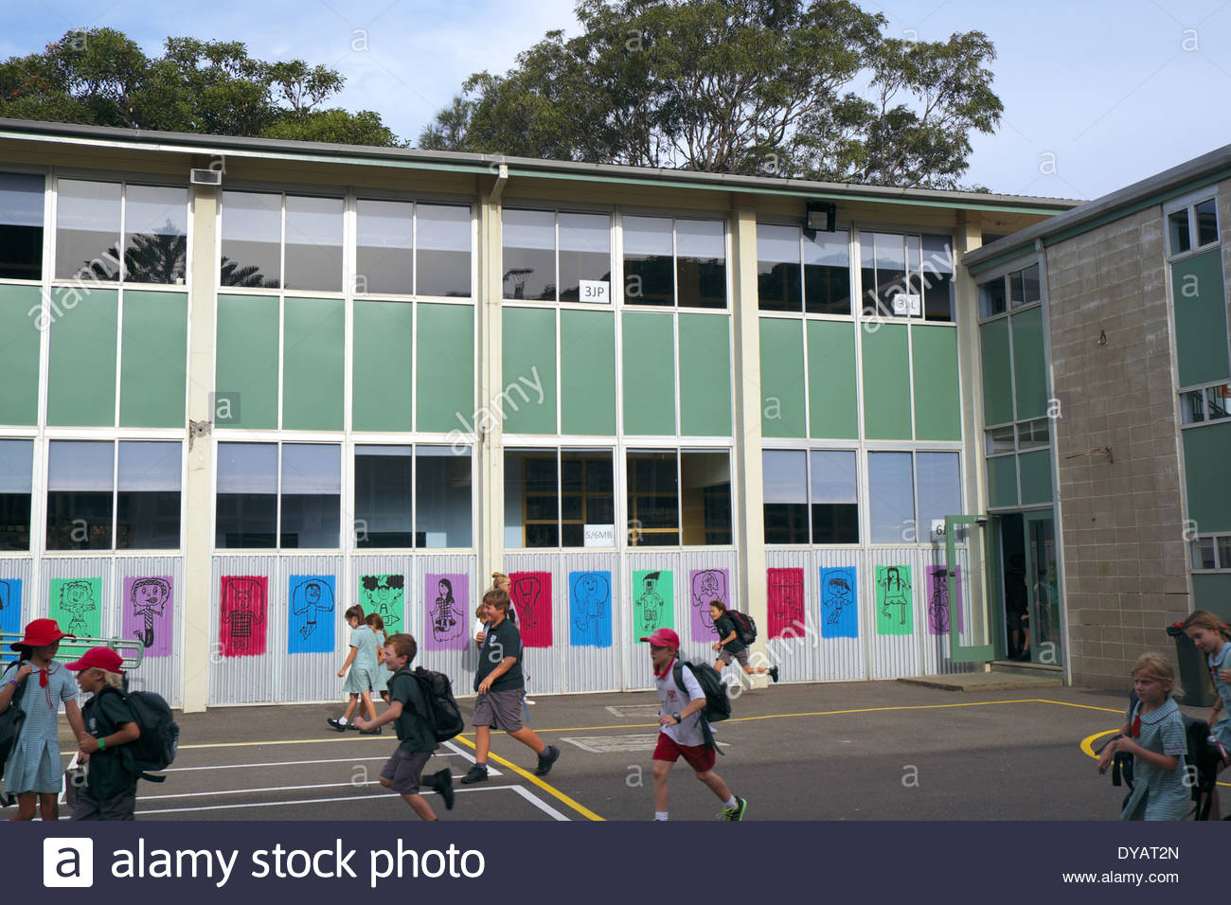

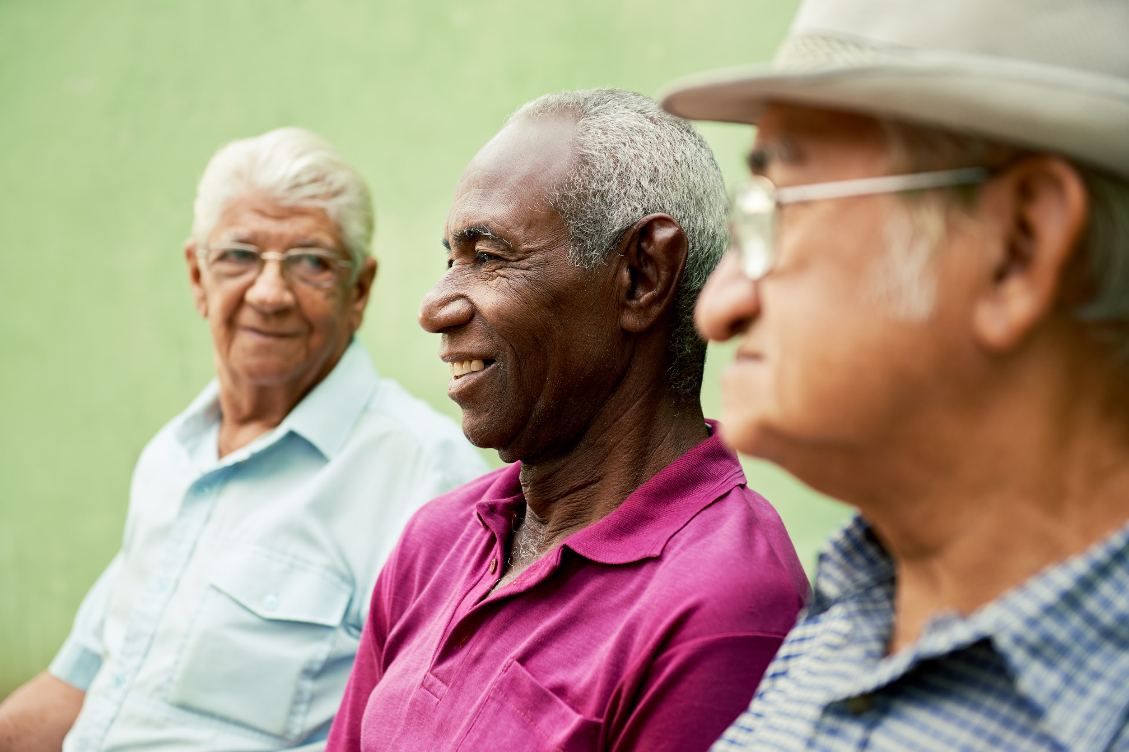

5. Stage of life

Slide 7

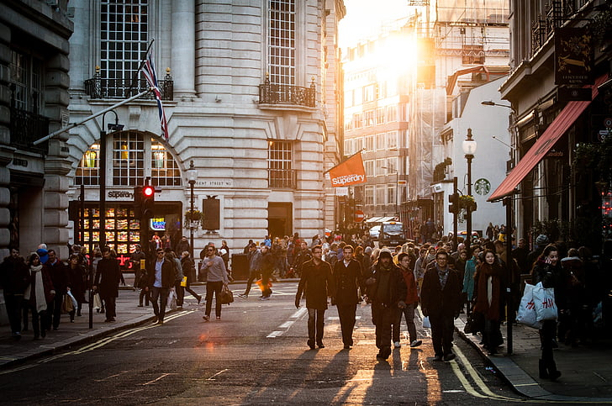
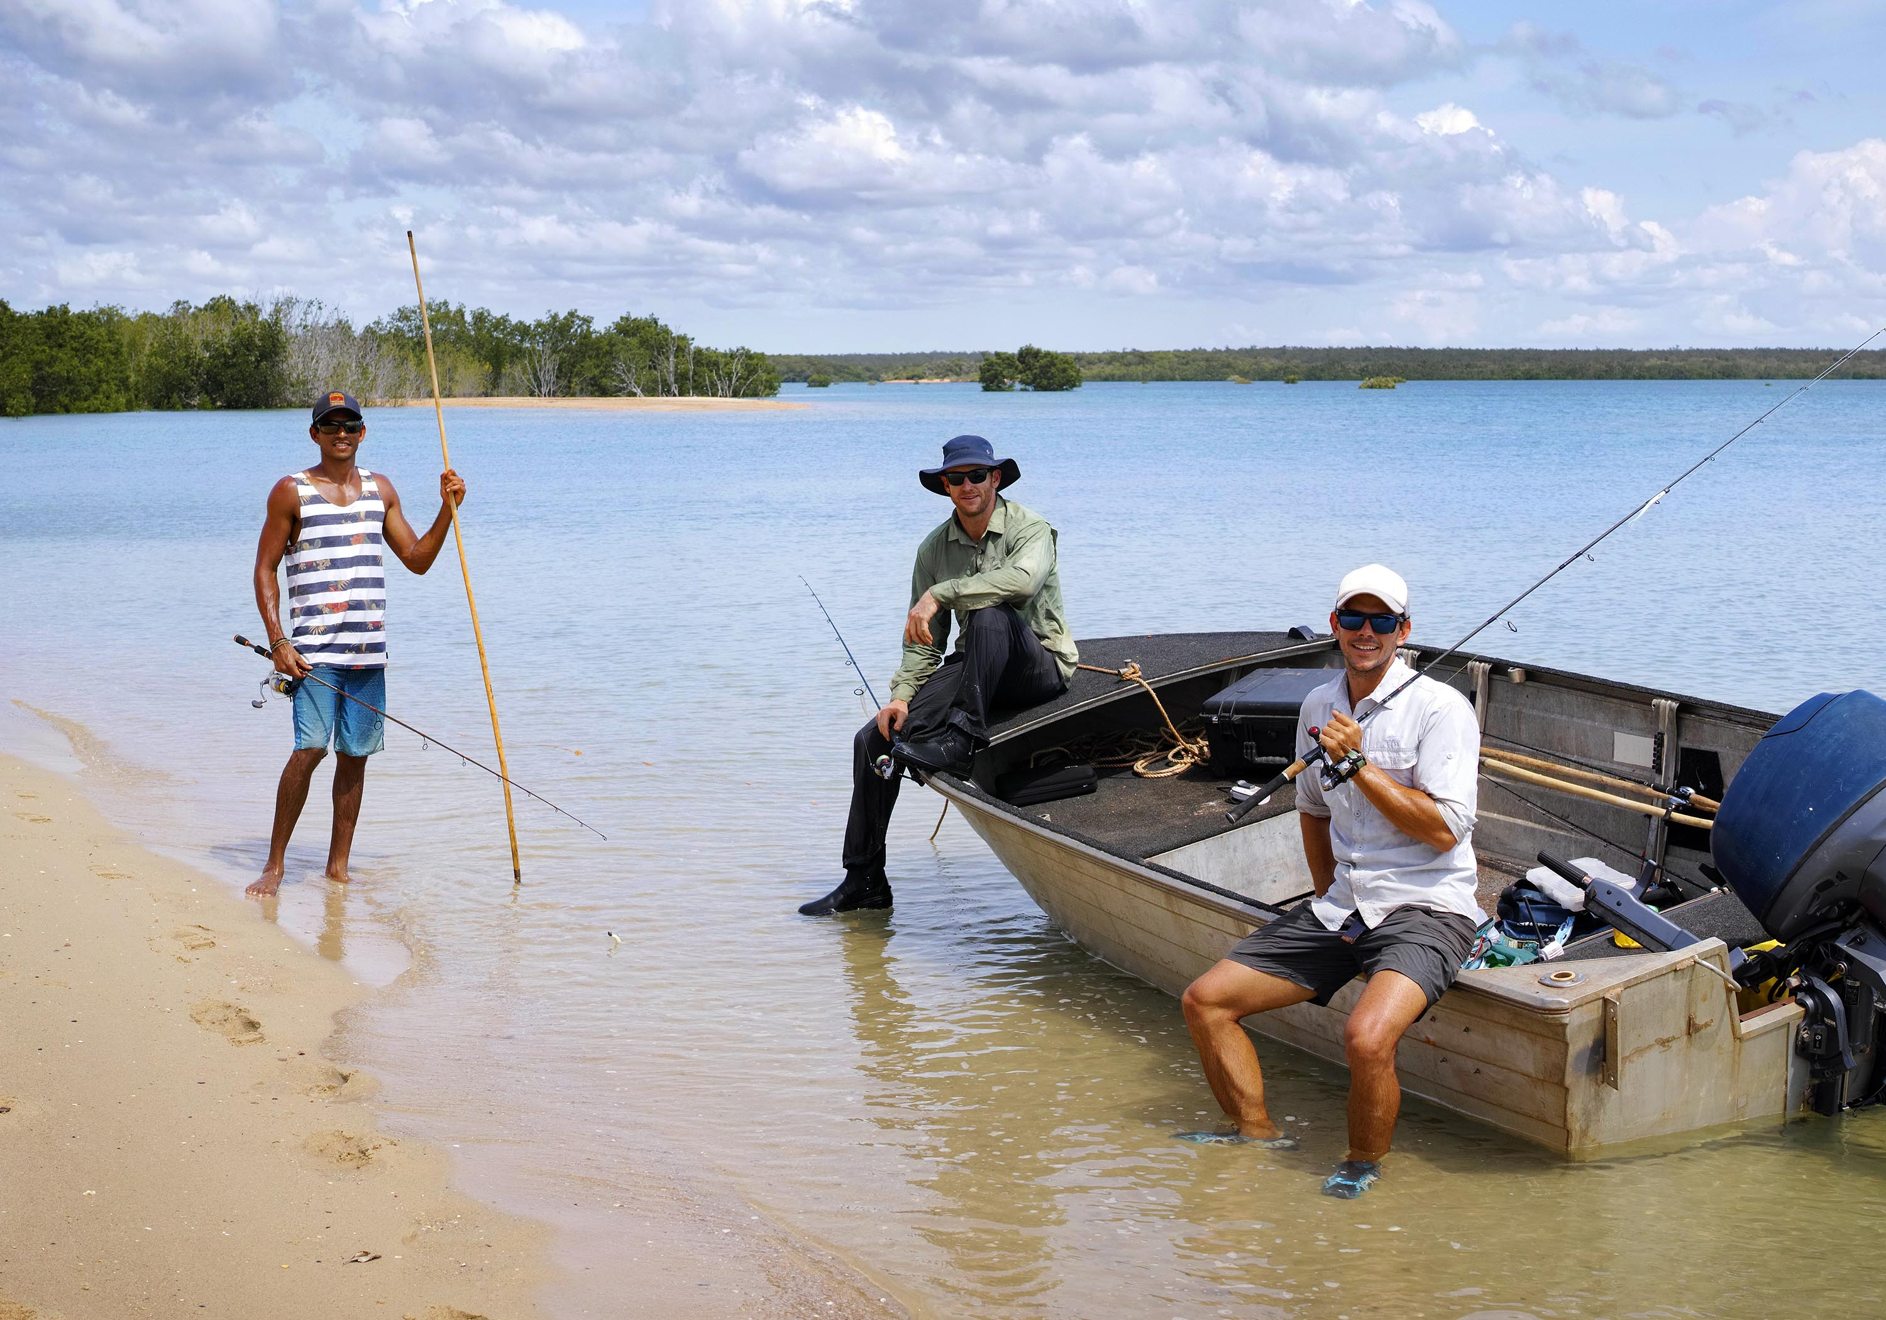
6. Lifestyle

Slide 8
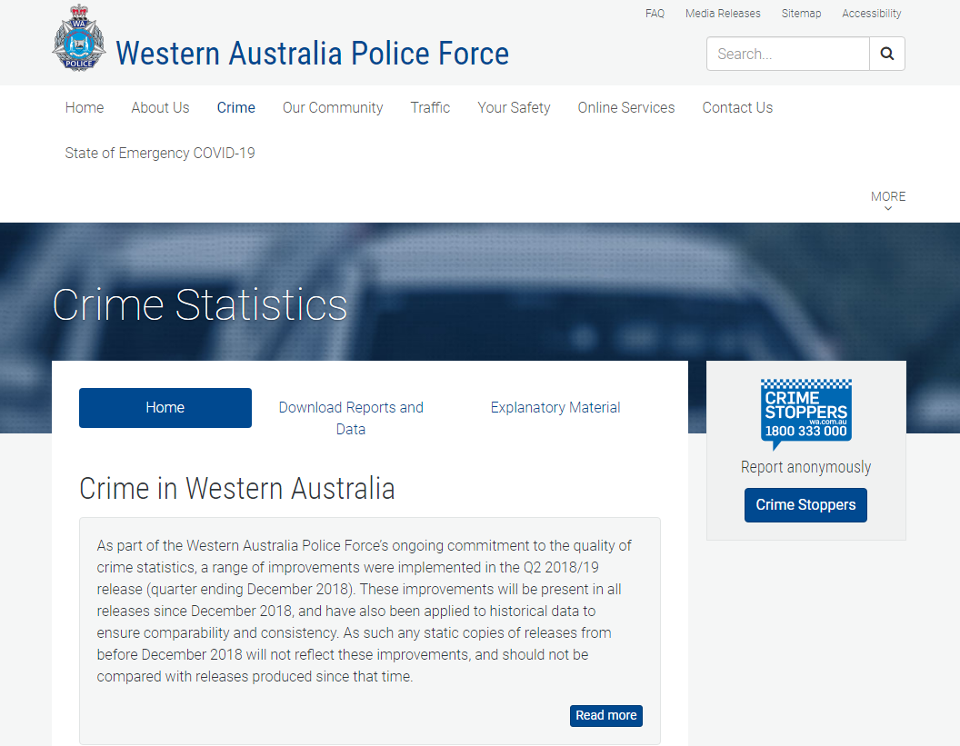
7. Personal safety
https://www.police.wa.gov.au/Crime/CrimeStatistics#/

Slide 9
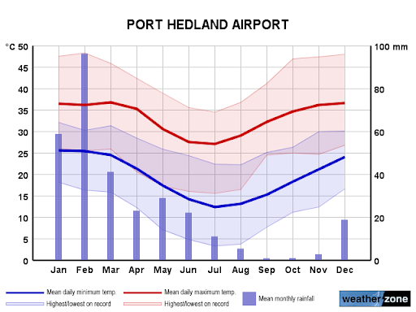
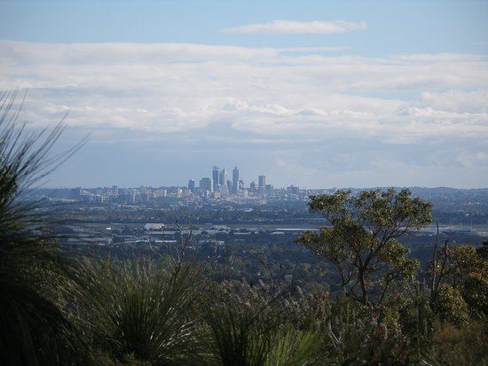
8. Environmental Factors (e.g. Climate)

Slide 10
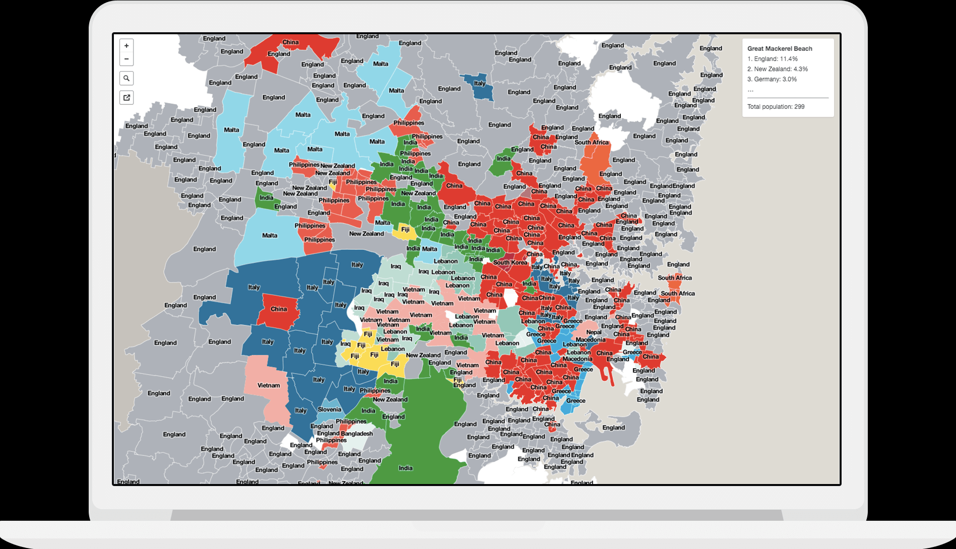
9. Culture and ethnicity
https://smallmultiples.com.au/projects/mapping-immigrants-birth-places/

Slide 11
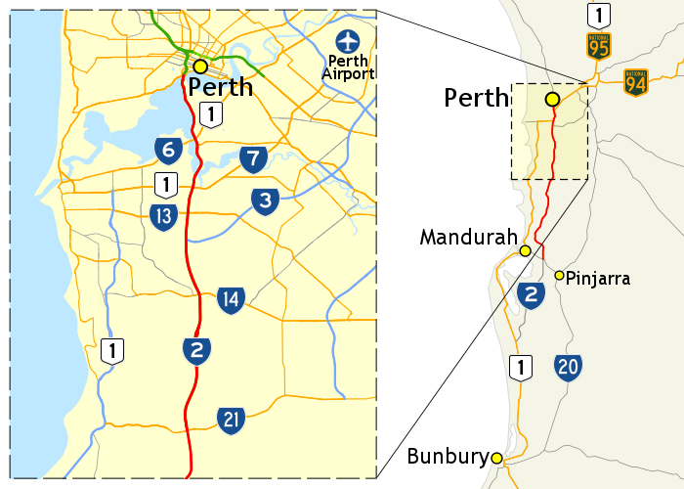
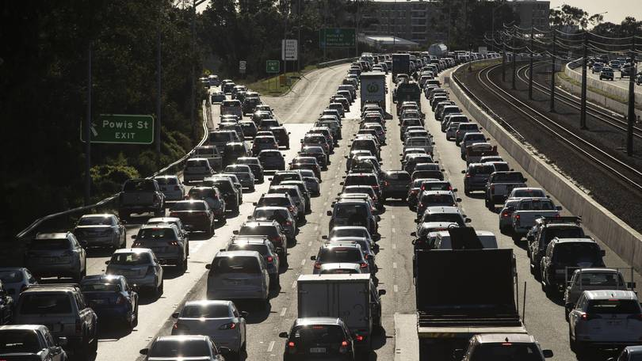
10. Travel time and transport options

